Slide 1
LASSWADE HIGH SCHOOL GROUPS/CLUBS INFORMATION
Tuesday 10th March 2020

Slide 2
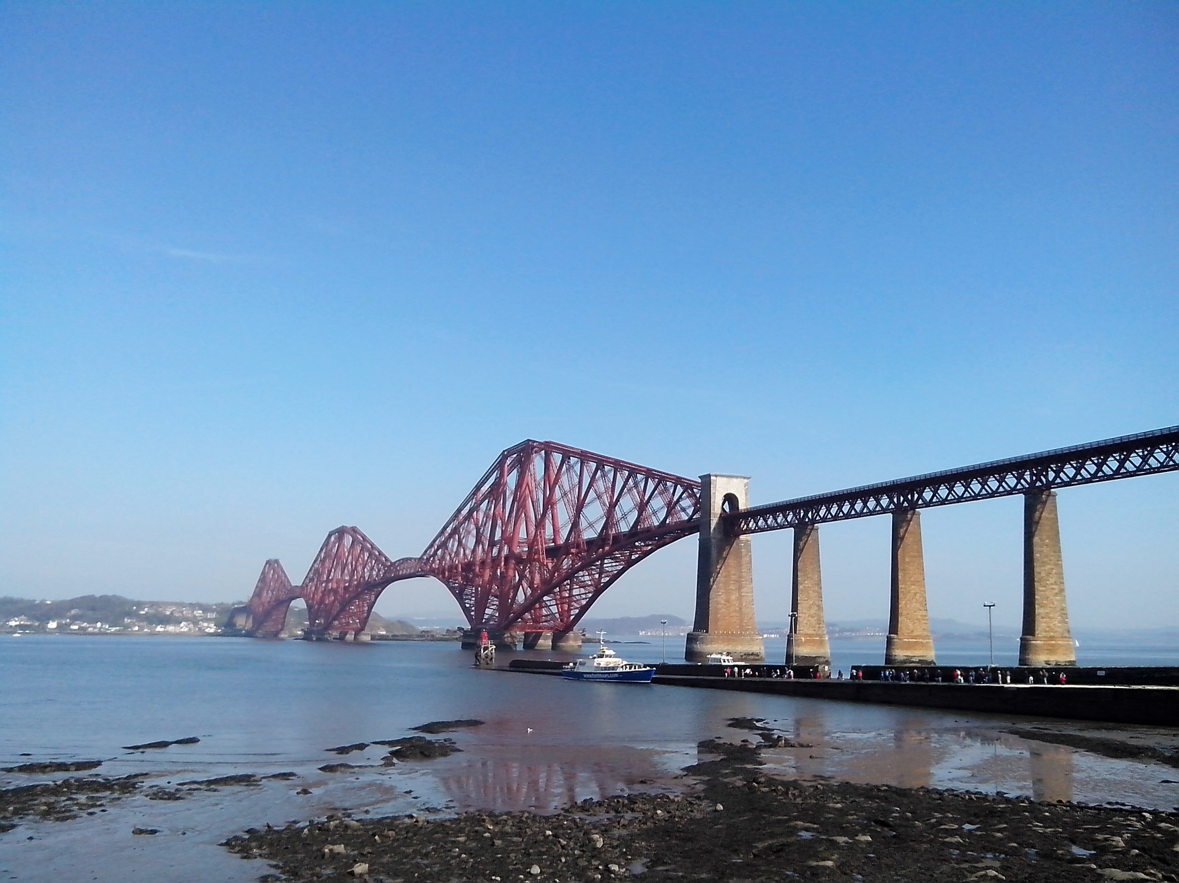
John Muir Award club 2020
If you are part of this group please come along to an important meeting on Tuesday 10th March at 1.20pm in room 118

Slide 3
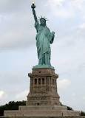
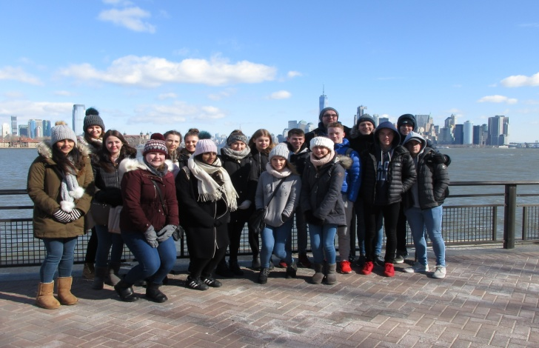
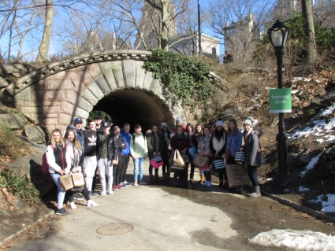
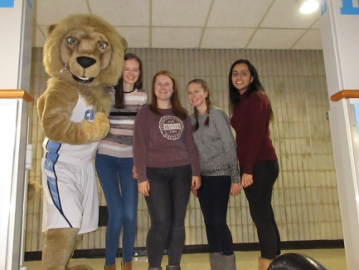
S4 & S5 Students New York 2021
Interested in coming to New York in the Feb break next year. (2021)
Come to meeting in Room 306 at 1.30pm on
Thursday 12th March.
If you are interested but can not make the meeting – see Miss Edmond for a letter.

Slide 4
The Fair Trade group are launching a competition to raise money for Fair Trade.
Keep your eyes peeled for the Fair Trade group at break and lunch this week or come see Miss Dowie in room 216 to enter.
All you need to do is make a donation to guess how many Maltesers are in the jar. The person with the closest guess will win some Fair Trade goodies and a £20 voucher!!

Slide 5
Come to the Movie Club in Room 120 (Miss McLeod’s room) where movies begin on a Wednesday lunchtime and resume at the same time on Thursdays! Movies begin shortly after lunch begins. The brilliant movie above will be shown next week. Come on your own or bring a friend! Bring hot dogs and popcorn!!

Slide 6
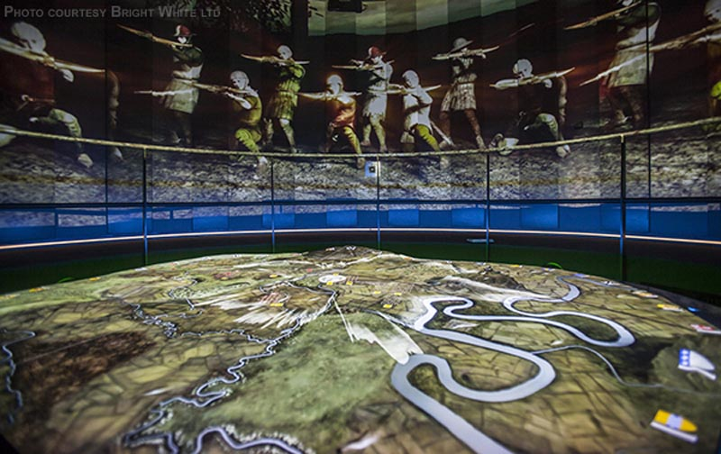
S1 HISTORY TRIP TO...
Tuesday 5th May
The cost of the trip is £7
See Mrs Sharp (room 116) for more information and a consent letter.
60 places. First come first served.

Slide 9
Congratulations to the following S1 students who are this months’ Social Studies Stars of the Month
Katie Smalley 1ME3
Genevieve Keith 1SL3
Elle Pearson 1SL1
Paddy Shiell
Casey Latimer 1MK4
Taylor Kane 1MK1
They have excelled in one or more of the DREAM values, well done!

Slide 10
Congratulations to the following S2 students who are this months’ Social Studies Stars of the Month
Robyn Horsburgh 2MK2
Connor Farricker 2MK3
Roisin Free 2SL2
Luca Cervi 2SL3
Lucy Foster 2MK4
Aaron Thompson 2SA1
Patrick Coughlin 2SL1
Georgia Graham 2ME2
Nadia McLennan 2SL3
They have excelled in one or more of the DREAM values, well done!

Slide 11
Dance Show
Tickets £3
On Sale in PE & Atrium next week
Thursday 12th March
Thursday 12th March

Slide 12
Lucy Foster
S2
Synchro Swimming
Lauren Innes
S4
Dancing
Elena Clark
S4
Athletics
Niall Kemp
S4
Football
WHO WILL GET YOUR VOTE?
CHECK OUT INSTAGRAM AND TWITTER TO SEE CAMPAIGN VIDEOS AND THEIR ACHIEVEMENTS.
#SP20
#SP20

Slide 13
S1/2 French Homework Club
Every Thursday from 1:05-1:35
Room 210
Mlle Gendreau

Slide 14
Challenge 24:
Have you ever wanted to be a book editor or illustrator?
Barrington Stoke publishers are looking for people to do this with a new book that they are going to publish soon.
Ask in the library for more details on how to get involved.

Slide 15
Free entry for all Midlothian pupils! Enter a team for School glory and House Points. Raise money for MYPAS and get fit! Still time to do Couch to 5k if you have never run! See Mrs Wilkins for entry details (password) – if she can do it, anyone can! https://www.bluebelltrail.co.uk/

