Slide 1
Effective Revision
Parent Information Evening
Monday 20th November 2023
Notes:
Lynsey

Slide 2
Aims
To outline what makes effective revision and the role parents can play in this
To share approaches which parents can use to support learners with their revision
To share resources which are available to help support learners with their revision
Notes:
Lynsey

Slide 3
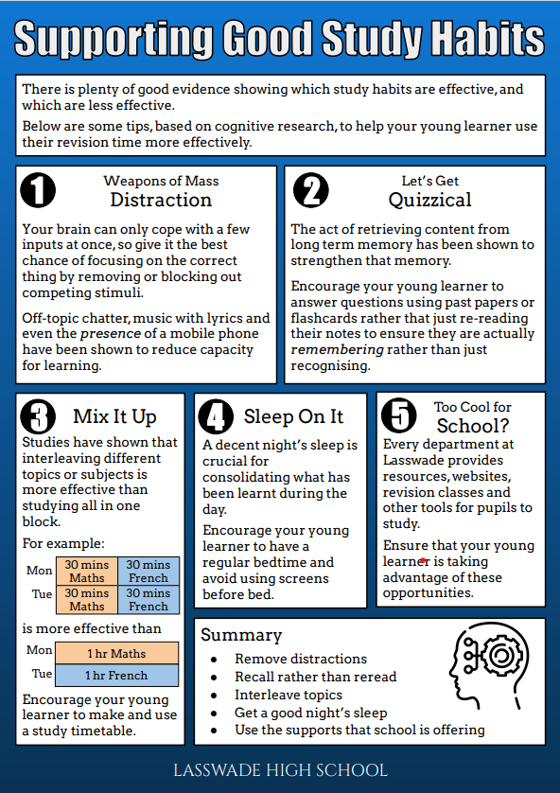
Notes:
Emma

Slide 4
Supporting wellbeing
Talk about exam nerves
Watch for signs of stress
Make sure they eat well
Help them get enough sleep
Be flexible
Encourage exercise
Help them study…
Notes:
Emma

Slide 5
Supporting wellbeing
You know your child best! Make sure their revision is tailored to how they work, what is already going on in their lives, what motivates them.
For example, consider:
What support they need from you- is it to remove distractions like the phone? Is it to help them take a break?
What time of day or days of the week they will most effectively be able to study.
Talk about exam nerves
Watch for signs of stress
Make sure they eat well
Help them get enough sleep
Be flexible
Encourage exercise
Help them study…
Notes:
Emma

Slide 6
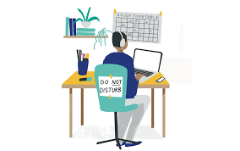
2. How do we ‘help them study’?
Preparing to study effectively
Space for revision
Create space to study
Ideally this is away from distractions (games consoles, phone) and where they sleep.
Work out with them beforehand what they need (highlighters, Chromebook…)
Notes:
Emma
Mention how many say that music helps them revise- research says music without lyrics or that is familiar. How can they have this without a phone?
They do not always need a chromebook- having it when it isn’t necessary means it becomes a distraction

Slide 7
2. How do we ‘help them study’?
Preparing to study effectively
Plan for it- create a study timetable and stick to it
Short blocks with short breaks - work this out with timed practice, for example.
Vary between subjects/ topics every revision session. Don’t just focus on the next assessment
Start in advance. Cramming only works for short term learning- eg. if you cram for a prelim you won’t remember it come the exam
Build in upcoming assessments (see whole school calendar) and SQA exam dates
Don’t forget to build in breaks, free time and rewards
SQA have a MyStudyPlan app to supports the creation of a timetable
Notes:
Emma

Slide 8
3. How do we ‘help them study’?
At home revision methods
What to do when they say:
“I have nothing to revise”
“ I don’t know what to do?”
Notes:
Emma

Slide 9
3. How do we ‘help them study’?
Revision methods
Google Classroom
See for individual class/ subject resources
Lesson resources to catch up or recap
Specific revision resources, eg practise questions
Notes:
Emma
Demo:
Google Classroom- https://classroom.google.com/c/NjExODU5MDYwNTA3

Slide 10
3. How do we ‘help them study’?
Revision methods
What not to do:
Read over notes
Highlight with no purpose (they need to then do something with the highlighted information)
Re-writing notes
Revising without testing yourself- how do you know it is working?
All knowledge, no skill or application
Focusing too much time on their strengths
Taking a big ‘break’ and losing momentum
Notes:
Emma

Slide 11
3. How do we ‘help them study’?
Revision methods
Knowledge
Mind maps
Flashcards/ Quizlet
Putting notes into your own words and condensing them
Test yourself
Skills
Timed practise
Targeted practise- planning or just one element
Critically check if the work is correct
Both
Past paper questions
Using past paper marking schemes
Asking if stuck!
Notes:
Erin

Slide 12
3. How do we ‘help them study’?
Study Skills Workshops
Wednesday 22nd and Thursday 23rd November 15:30-16:30
Designed to make students aware of different revision methods
Examples from a range of subjects to help all students
Support students to make a realistic study timetable
Direct them to useful websites
Google Classroom Code: cayhucw
Notes:
Erin

Slide 13
4. Resources to support revision
Supported Study
Timetable on Google Classrooms and school website
Learners can attend any, not just one by offered by their timetabled teacher
Achieve https://achieve.hashtag-learning.co.uk/
School joining code Zx7tGreK
Learn, Assess and Self-Evaluate features are great for guiding independent revision
For features help guides: https://achieve.hashtag-learning.co.uk/base/help-menu/
SQA Past Papers https://www.sqa.org.uk/pastpapers/findpastpaper.htm
Notes:
Erin
Demo:
Supported Study timetable- https://docs.google.com/spreadsheets/d/1AgIlUKGQE1hBEZhD04CfXp9U3r0ziNP-/edit#gid=2006709726
Achieve- https://achieve.hashtag-learning.co.uk/

Slide 14
How do we help them when we don’t understand what they’re doing?
Ask The Right Questions - process based…
What do you think is making it hard for you to work on this question/ essay right now?
What are some strategies that have helped you do well on similar questions/ essays in the past?
How did your teacher do it in class… could you teach me?
Can you use those to help you with the work you’re doing now?
How could you check this?
What do you do when you’re stuck in (another subject they’re more confident in)
Process based praise
You’ve worked so hard on that…
That’s impressive, the way you worked out what to do…
Notes:
Lynsey

Slide 15
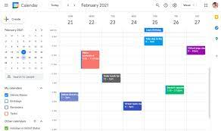
5. Assessment Calendar
Use this resource to prepare individualised assessment timetable
‘How to’ video is available on the school website and on year group Google Classrooms.
This calendar will also show homework assignment so, if used well, it can really support you child in managing their study and time.
Use different ‘views’ to look at the month or week ahead together.
Notes:
Lynsey

Slide 16
Next Steps
Supported Study Timetable on Google Classrooms and website
Study Skills Workshops
Easter School
Pre-exam grade booster days
Study Skills for BGE learners
What more do you need to know?
What else can we do as a school?
Feedback Google Form- https://forms.gle/hrUdZYenow7k7mEP8

Slide 17
Any questions?

