Slide 1
Lasswade High School
SQA Exams 2024
Information for Students March 2024

Slide 2
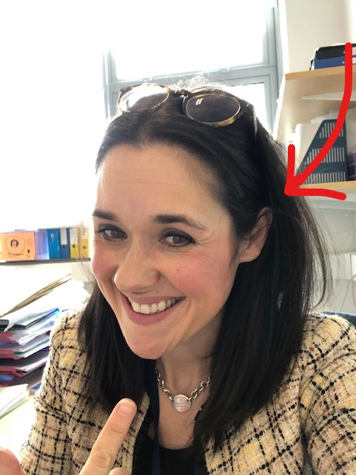
Contents
Key Dates, Study Leave and In-school Supports
SQA’s Your Exams and your Exam Timetable
On the Day Tips for Success and Exam Room Conduct
What if something goes wrong?
Exceptional Circumstances
Your Estimate Results
Results and Appeals Service
Leavers
Happy to help!

Slide 3
Exam Key Dates
In School Supports
This year, the exams will run from 22nd April - 29th May.
Study leave will be from 29th April - 29th May (inclusive).
Monday 20th May (in-service) – students should attend exams as normal.
Results will be issued on Tuesday 6th August.
Throughout the exam period the library will remain open as a study space for students.
Easter School, as well as a range of Grade Booster sessions are planned to support with revision in the run up to final exams. Grade Boosters are likely to be online.
Wellbeing supports are accessible through student support.

Slide 4
SQA’s Your Exams
Your Exam Timetable
SQA have produced a document called Your Exams to provide you with key information about the exam diet.
My SQA (you need an address and SCN)
Apps that are useful for planning your exams and study
You are being given your exam timetable today/ tomorrow. It is important that you check this carefully.
If you have AAAs you will also have these to check and sign. See Mr Hunter if there are any issues ASAP.
If there are any exams missing, or any you have been listed for (but should not be) you must let Ms Struthers know ASAP.
Please check to make sure your personal details are up to date - you should have already checked these but any issues need to be reported to Ms Struthers/ School office.
OUR EXAM TIMES ARE DIFFERENT. MOST OF OUR MORNING EXAMS WILL
BEGIN AT 8:30AM. DO NOT USE EXAM BUILDER APP FOR TIMINGS.

Slide 5
On the Day Tips for Success
Aim to get a good night’s sleep.
Aim to get up with plenty of time and have a breakfast.
Check the big boards when you come in - they have your seats and SCNs
Arrive early - many exams begin at 8:30, so you should be outside the hall (or classroom being used) by 8:20, to allow for seating.
Afternoon exams require you to arrive early too - be clear about where you’re going.
Know where you need to be - boards will be up as a reminder.
Listen carefully to the invigilators.
Bring water, this can be placed at side of your desk (on the floor).
Bring spare pens.
Wear a watch (not a smartwatch)- this means it doesn’t matter where the clock is!
Use all the time that’s available - go back to Qs you’re unsure of, check to see if you can improve a response…
Stay calm. Remember, exams make everyone nervous… so what you’re feeling is very normal.

Slide 6
Exam Room Conduct
Bags left at back of room with phone in it – switched off.
No talking.
Water on the floor.
No pencil case.
If you finish early (you should be using all the available time) rest your head on the desk, don’t look around.
You shouldn’t be taking any materials out of the exam – including the question paper.
No notes of any kind.
No smart watches.
No earpods.
No calculators or dictionaries (unless explicitly required)
No sharing equipment.

Slide 7
What if something goes wrong?
Running late:
No entry after 30 minutes
Report to Ms Struthers/ invigilator ASAP
Know your seat
Other issues on the day/ in the exam:
Invigilation team are trained to manage range of issues; they will assist you.
Any concerns about AAAs will be managed by Mr Hunter, who will be on hand each day.
Come to Ms Struthers in 112 if you have any other concerns.
TELL SOMEONE IF THERE IS A PROBLEM!

Slide 8
Exam Fire Evacuation Procedures
In the unlikely event of a fire alarm, it is critical that you stay calm and follow the following instructions:
Stop working on your paper.
Leave all your belongings behind you
Exit the school at the nearest exit - your invigilator will remain with you and your exam room group.
Assemble at the S4-6 area at the grass playing fields - your invigilator will remain with you, and other staff will join you at this point.
Do not discuss the exam.
If possible the exam will be restarted - it is therefore vital that you do not discuss the exam or have access to your phone at any point.

Slide 9
Exceptional Circumstances
If you are unable to attend your exam you MUST let the school know. It may be that you are eligible for the SQA’s Exceptional Circumstances Service.
The Exceptional Circumstances service works to ensure that any candidates who are unable to attend their exam can have their school held evidence considered, alongside other work (eg. assignments, folios) to provide them with a final grade.
Failure to attend the exam does not mean you are entitled to use the EC service - you would need to have genuinely ‘exceptional circumstances’.
Any student who use the EC service will have their final grade provided by the SQA in August, in line with all other results.

Slide 10
Results and Appeals
Results will be issued to you in the post on Tuesday 6th August. You can also have them emailed or sent by text message - signing up through MySQA is the quickest way to get your results.
Schools will get your results at the same time and if you are a UCAS applicant your results will also be sent on to college/ universities too.
If your results are not what you were expecting then you might wish to consider an appeal.
This year anyone can appeal. The process will involve a check of your exam paper/ coursework submitted to the SQA. This means that any work you have completed in class will not be sent away or considered.

Slide 12
Stay Positive. Work Hard. Make it happen.

