Slide 1
CREATIVITY | EFFORT | KINDNESS | RESPECT

Slide 2
P7 Transition 2024:
Family Information
Session 1
CREATIVITY | EFFORT | KINDNESS | RESPECT

Slide 3
AIMS:
Provide further support to students and families transitioning to Lasswade High School in August.
Share useful transition information and connect with key members of staff.
Allow parents/carers to ask questions and clarify their understanding of transition.
Inform students and families of the next steps in the transition process.
CREATIVITY | EFFORT | KINDNESS | RESPECT

Slide 4
Welcome to Session 1
‘My Lasswade’
Welcome to Lasswade High School
P7/S1 Transition Team Roles & Responsibilities
School Information
Transition Programme Overview
*Please type any questions into the chat*
Turns on captions and translation options if required
CREATIVITY | EFFORT | KINDNESS | RESPECT
Notes:
Emma

Slide 5
P7/S1 Transition Team Roles & Responsibilities
Campbell Hornell
Head Teacher
CREATIVITY | EFFORT | KINDNESS | RESPECT

Slide 6
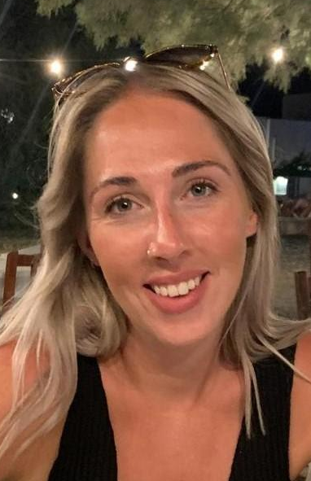
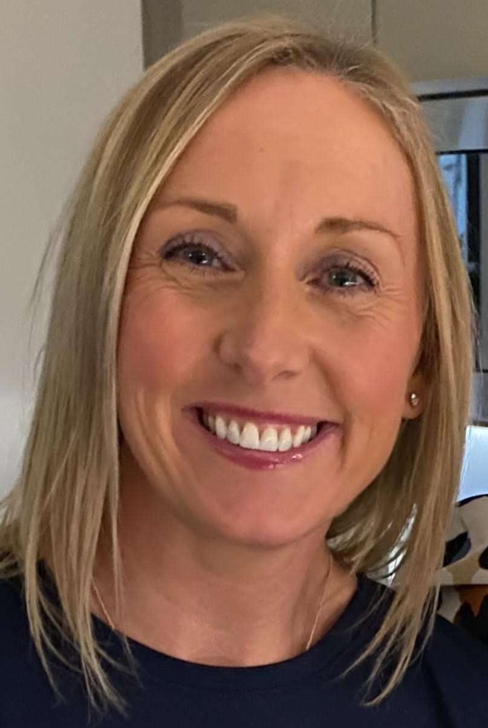
P7/S1 Transition Team Roles & Responsibilities
Emma Whittingham
DHT S1/S2
Claire Main
SL Head of House
CREATIVITY | EFFORT | KINDNESS | RESPECT
Notes:
Emma

Slide 7
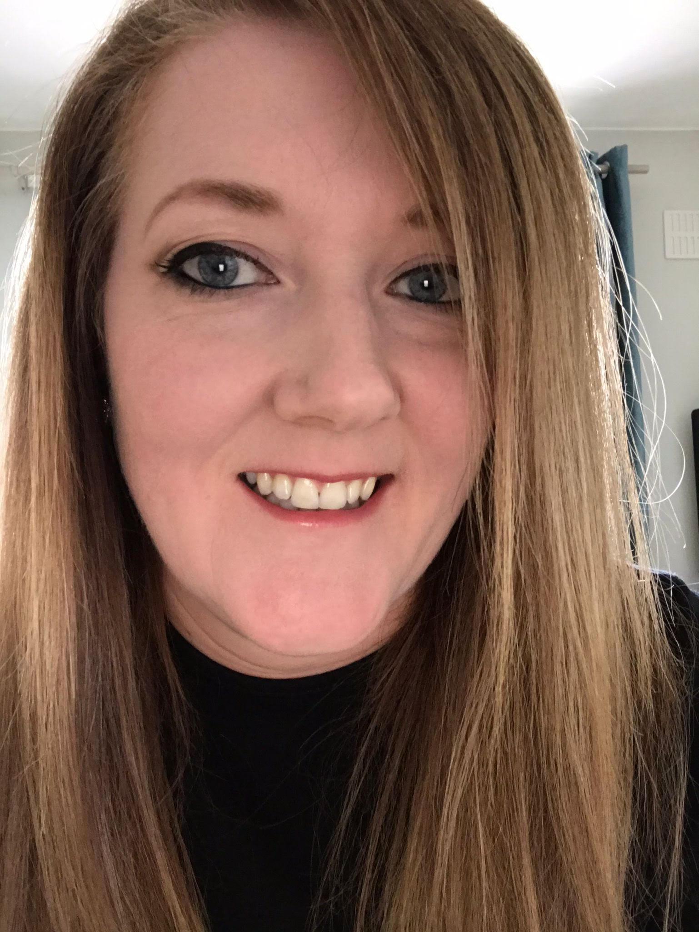
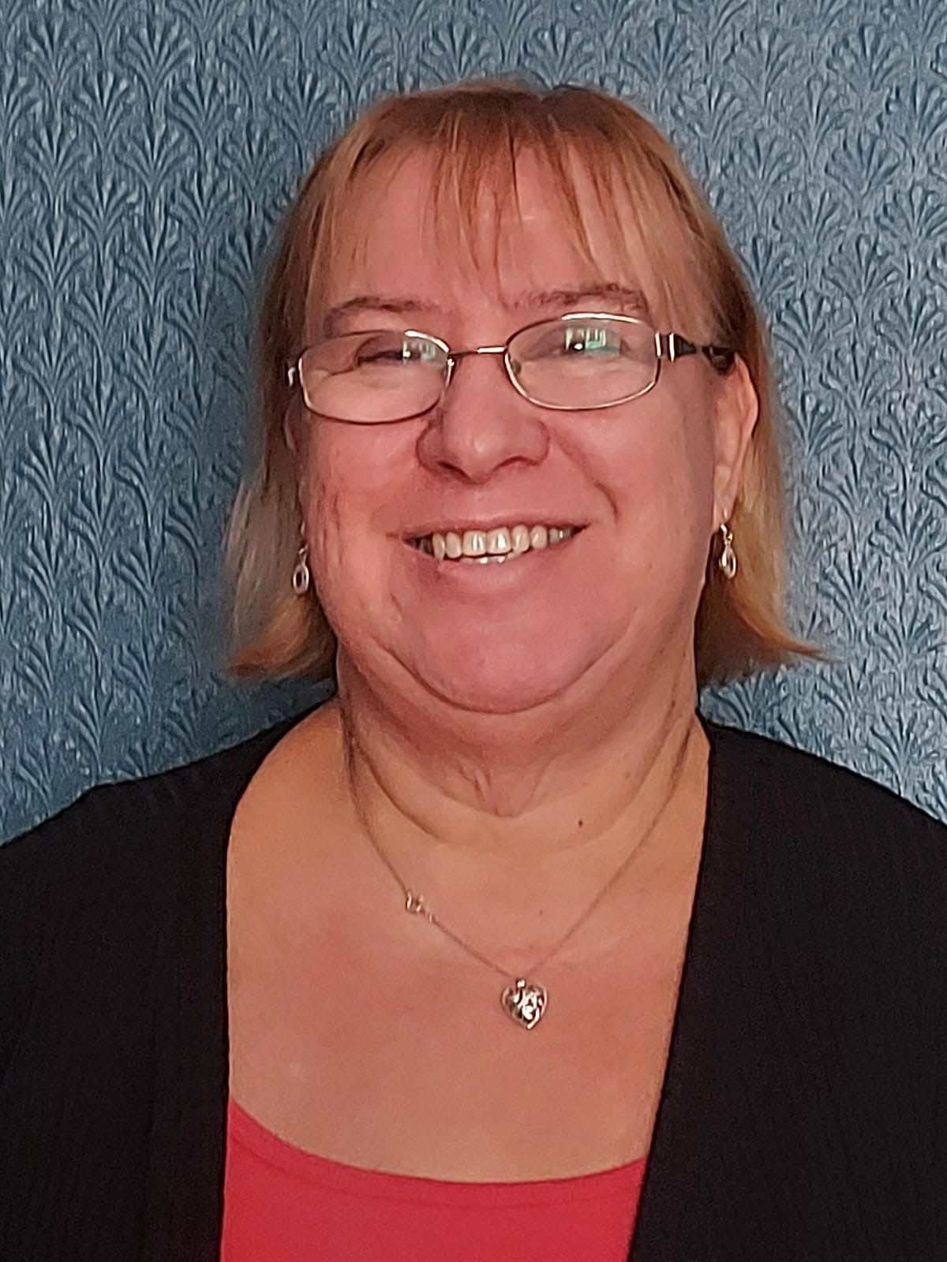
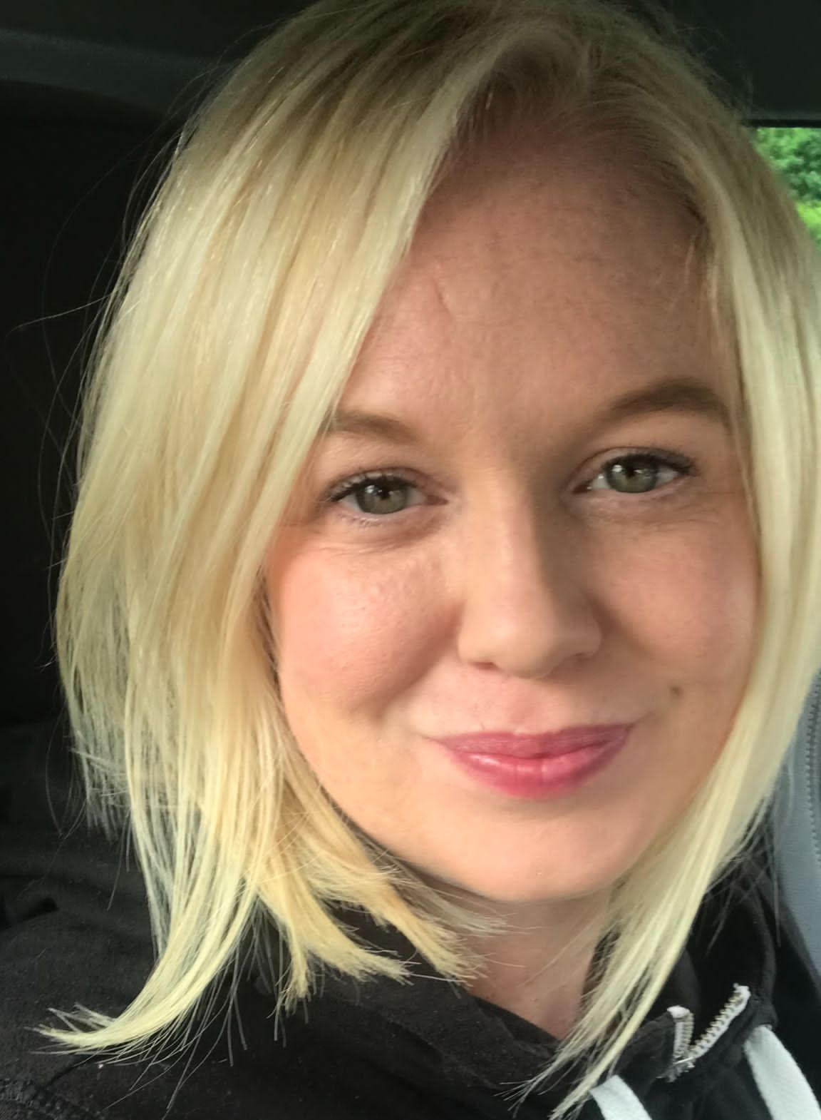
P7/S1 Transition Team Roles & Responsibilities
Claire Anderson
PT Literacy
Susan Ramsay
PCWO SA
Lisa Paton
PT Creative Learning
CREATIVITY | EFFORT | KINDNESS | RESPECT
Notes:
Emma

Slide 8
Mr Hornell, Head Teacher
School Values
School News
School Communication, e.g. HT Update; school website click here
School Handbook; school website click here
Student Voice
School Uniform; school website click here
HT’s ‘Mission’; https://m.youtube.com/watch?v=omPdemwaNzQ
*All links will be shared on the school website by the end of this week.
CREATIVITY | EFFORT | KINDNESS | RESPECT
Notes:
Campbell

Slide 9
Miss Whittingham, DHT
Chromebooks
Key tool for learning
Safe storage & usage
Chargers
‘Light Speed’ firewall software
CREATIVITY | EFFORT | KINDNESS | RESPECT
Notes:
Emma

Slide 10
Uniform
Wednesday 22nd May, 4-6pm
Half zip top prices:
£25.30 until end of May (LHS special offer)
£28 as a discounted price, end date TBC
£35 full price
CREATIVITY | EFFORT | KINDNESS | RESPECT
Notes:
Emma

Slide 11
Transition Programme Overview
Week Beginning | Virtual Transition Programme | Visits | Online Family Sessions
6th May | P7 Google Classroom Tasks | Enhanced transition programme | My Lasswade
13th May
20th May |  |  | My Learning
27th May
3rd June |  | LHS staff visits to primaries | My Support
10th June |  | Transition days at LHS
CREATIVITY | EFFORT | KINDNESS | RESPECT
Notes:
Claire

Slide 12
Virtual P7 Transition
Online, clear, fun and interactive (optional)
Shared with P7 students on Google Classroom
Class code: gh6yvdm
From January to May 2024
CREATIVITY | EFFORT | KINDNESS | RESPECT
Notes:
Claire

Slide 13
LHS Staff Visits
Monday 3rd June - Friday 7th June
Key members of P7/S1 Transition Team, plus Student Voice reps
Share useful information i.e. first day arrangements, S6 buddies, school bus service etc
Answer questions
Monday 10th June- ‘S1 class cards’
CREATIVITY | EFFORT | KINDNESS | RESPECT
Notes:
Claire

Slide 14
Transition Days
Wednesday 12th - Friday 14th June (2.5 days)
Timetable - flavour of subjects
Meet Transition Team & wider staff
Tour
S6 Buddies
Assemblies & activities
Transport arranged (Paradykes & Loanhead Primary Schools)
Free lunch for all
CREATIVITY | EFFORT | KINDNESS | RESPECT
Notes:
Claire

Slide 15
Family Transition Programme Overview
My Lasswade 09/05/24 | My Learning 21/05/24 | My Support 05/06/24
P7/S1 Transition Team | Lasswade Curriculum | Student Support
Key School Information | English, Maths, Social Studies, Science, Creative Design | Creative Learning
Transition Programme |  | Wider Achievement & Extra-Curricular Opportunities
 |  | S6 Buddies & Transition Days
CREATIVITY | EFFORT | KINDNESS | RESPECT
Notes:
Claire

Slide 16
Transition Programme Overview
P7 Transition Student Feedback
“Our S6 Buddies were amazing! They helped us get around the school, they visited us in classes and they were really friendly.”
“Lasswade is a really big school but the virtual tour helped me a lot. I felt that I sort of knew where I was going before I even started S1 in August.”
“During transition, just like in school, the teachers will give you a lot of support and very clear instructions.”
“We got to learn a lot about Lasswade and meet lots of staff
and our S6 Buddies.”
CREATIVITY | EFFORT | KINDNESS | RESPECT
Notes:
Emma

Slide 17
Communication
You can email your questions ahead of sessions.
Slides will be posted on the website after each session.
@LasswadeHSC
Lasswade High School Parent Council
@lasswadehighschool
http://lasswadehsc.mgfl.net/
transition.lasswade@midlothian.education
CREATIVITY | EFFORT | KINDNESS | RESPECT
Notes:
Emma

Slide 18
Questions?
CREATIVITY | EFFORT | KINDNESS | RESPECT

Slide 19
Staff Speakers
P7 Students
Families
See you next time:
Tuesday 21st May
‘My Learning’
Google Meet details to follow

