Slide 1
CREATIVITY | EFFORT | KINDNESS | RESPECT

Slide 2
P7 Transition 2024:
Family Information Session 3
CREATIVITY | EFFORT | KINDNESS | RESPECT

Slide 3
AIMS:
Provide further support to students and families transitioning to Lasswade High School in August.
Share useful transition information and connect with key members of staff.
Allow parents/carers to ask questions and clarify their understanding of transition.
Inform students and families of the next steps in the transition process.
CREATIVITY | EFFORT | KINDNESS | RESPECT

Slide 4
Welcome to Session 3
‘My Support’
Student Support Structure, Universal Supports
Structure of the School House System, Roles and Responsibilities, Personal Social Education, Inter-House Competitions
Targeted/Staged Support, Creative Learning Overview
Extra-Curricular Activities, Wider Achievement
Additional Supports for Students & Families
CREATIVITY | EFFORT | KINDNESS | RESPECT

Slide 5
Session 3: Staff/Guest Speakers
Mrs Yule DHT Student Support
Mrs Main Head of St Leonard’s House
Mrs Paton PT BGE Creative Learning
Miss Park Wider Achievement & Extra-Curricular & Active Schools
CREATIVITY | EFFORT | KINDNESS | RESPECT

Slide 6
Mrs Yule, DHT Student Support
Student Support at Lasswade
Staffing, Roles & Responsibilities
Information Sharing (with Primary Schools)
Universal Supports
Targeted & Staged Supports
Medical Requirements
Mental Health
CREATIVITY | EFFORT | KINDNESS | RESPECT

Slide 7
Melville Mr McQueen - Head of House Ms Crosbie - PT Tracking & Monitoring Mrs Jones – PCWO Mrs Burge - Creative Learning Link Ross – Youth Worker | Mount Esk Mrs Hughes - Head of House Mr Cairney - PT Tracking & Monitoring Mrs Bennett - PCWO Mr Turton - Creative Learning Link Shona – Youth Worker
St Anne’s Mrs McDermott- Head of House Mrs Wilkins - PT Tracking & Monitoring Mrs Ramsay – PCWO Mrs McConville - Creative Learning Link Grace – Youth Worker | St Leonard’s Mrs Main - Head of House Mrs Sharp - PT Tracking & Monitoring Mrs McCormack – PCWO Miss McNeil - Creative Learning Link Holly – Youth Worker
CREATIVITY | EFFORT | KINDNESS | RESPECT

Slide 8
Mrs Main, Head of House
Lasswade House System
Relationships
House Colours
Personal & Social Education
Pathways & Positive Destinations
CREATIVITY | EFFORT | KINDNESS | RESPECT
Notes:
CM - Melville Mount EskSt Anne’sSt Leonard’s

Slide 9
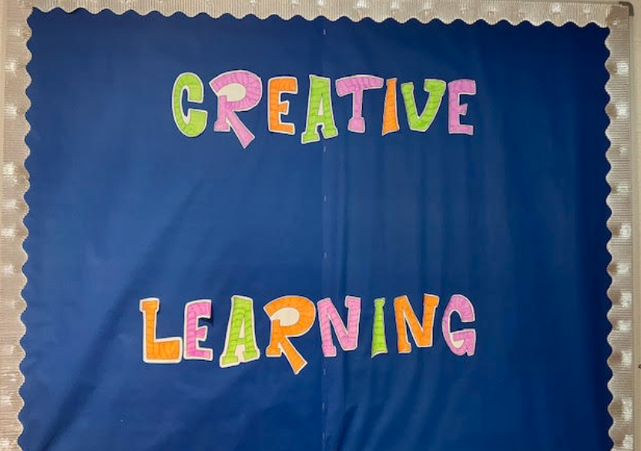
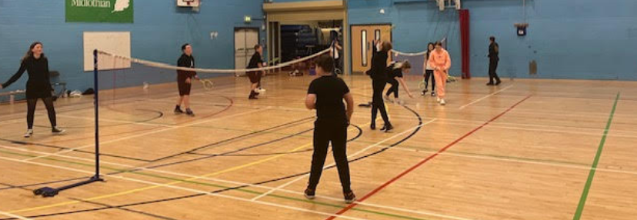
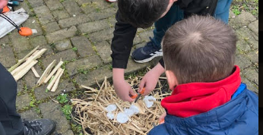
Mrs Paton - PT BGE Creative Learning
What is Creative Learning?
Who works in Creative Learning?
How can Creative Learning support my child?
CREATIVITY | EFFORT | KINDNESS | RESPECT

Slide 10
Miss Park, Wider Achievement
Wider Achievement Programme
Newsletter
Bronze, Silver and Gold award
Recognition assemblies
CREATIVITY | EFFORT | KINDNESS | RESPECT

Slide 11
Miss Park,
Extra-Curricular & Active Schools
Wider Achievement Programme
What’s on?
Why join?
‘Try Something NEW’
S1 Experience
Rewards
Progress
Extra-Curricular Opportunities
Required Experience/Skill Set
Payments
Active Schools
CREATIVITY | EFFORT | KINDNESS | RESPECT

Slide 12
PHYSICAL EDUCATION - EXTRA CURRICULAR

Slide 13
What’s on throughout the year?

Slide 14
Don’t miss out on upcoming opportunities…
Follow us on Twitter and Instagram!
@lasswadesports

Slide 15
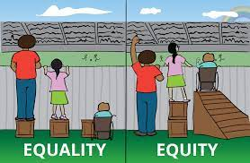
Miss Whittingham, Equity
Breakfast Club & Grab n Go Snacks
Free School Meals
https://www.midlothian.gov.uk/info/855/school_meals/117/free_school_meals_and_clothing_grants
Subject Payments (removed)
Clubs, Groups, Trips
Lasswade Uniform Cupboard
Secret Locker
Food Banks i.e. Midlothian Food Bank & LHS Xmas Hampers
Fundraising i.e. Mission Christmas
Local Community
CREATIVITY | EFFORT | KINDNESS | RESPECT

Slide 16
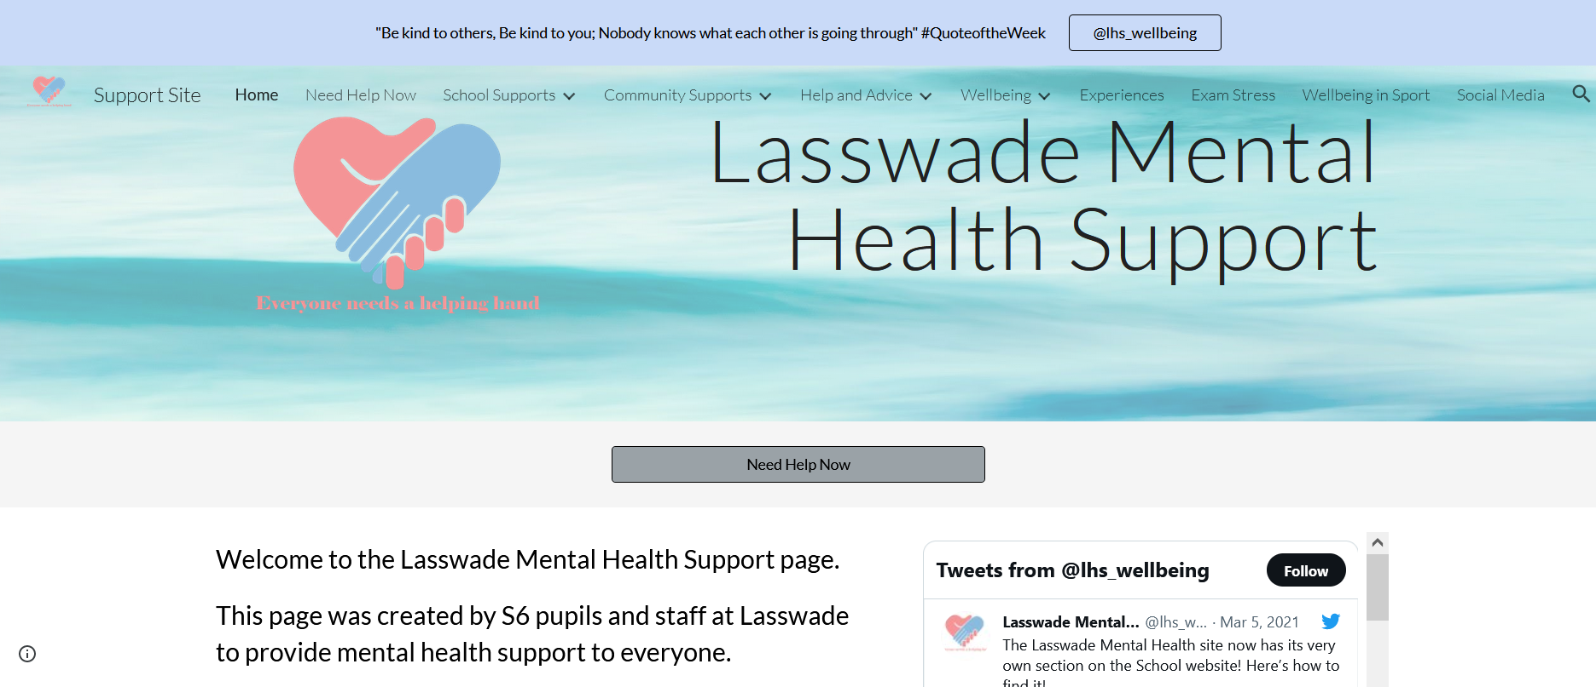
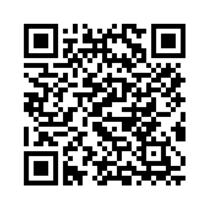
Mental Health Site
CREATIVITY | EFFORT | KINDNESS | RESPECT

Slide 17
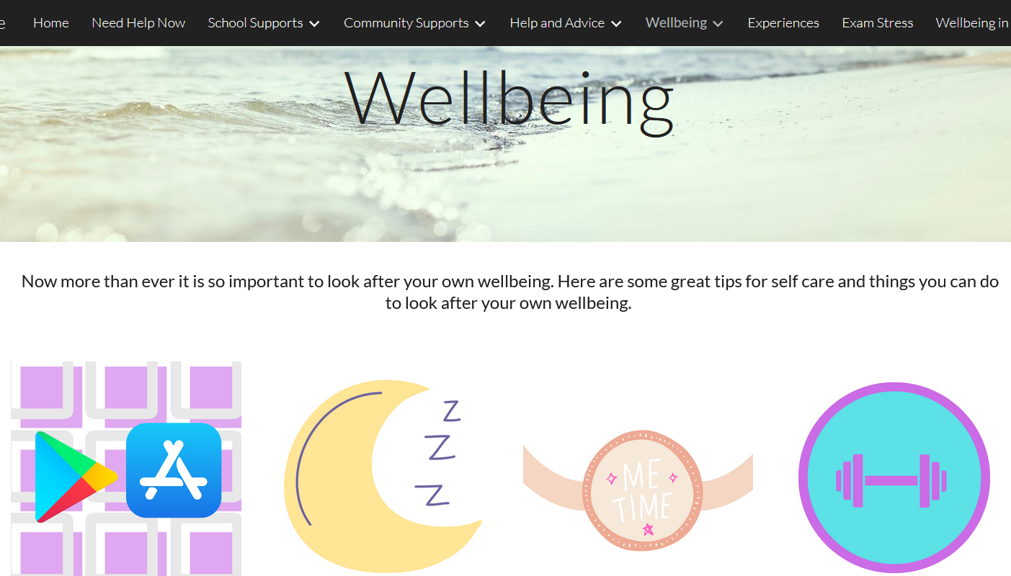
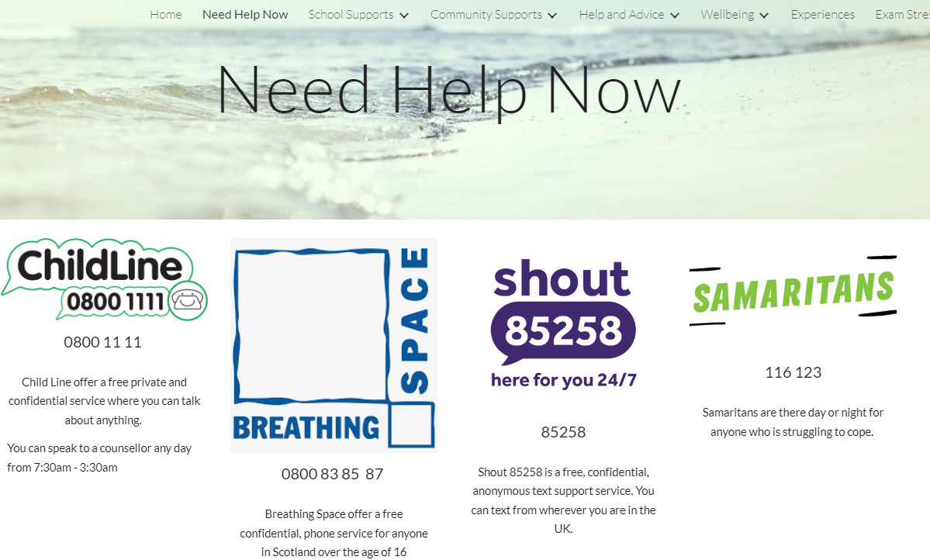

Slide 18
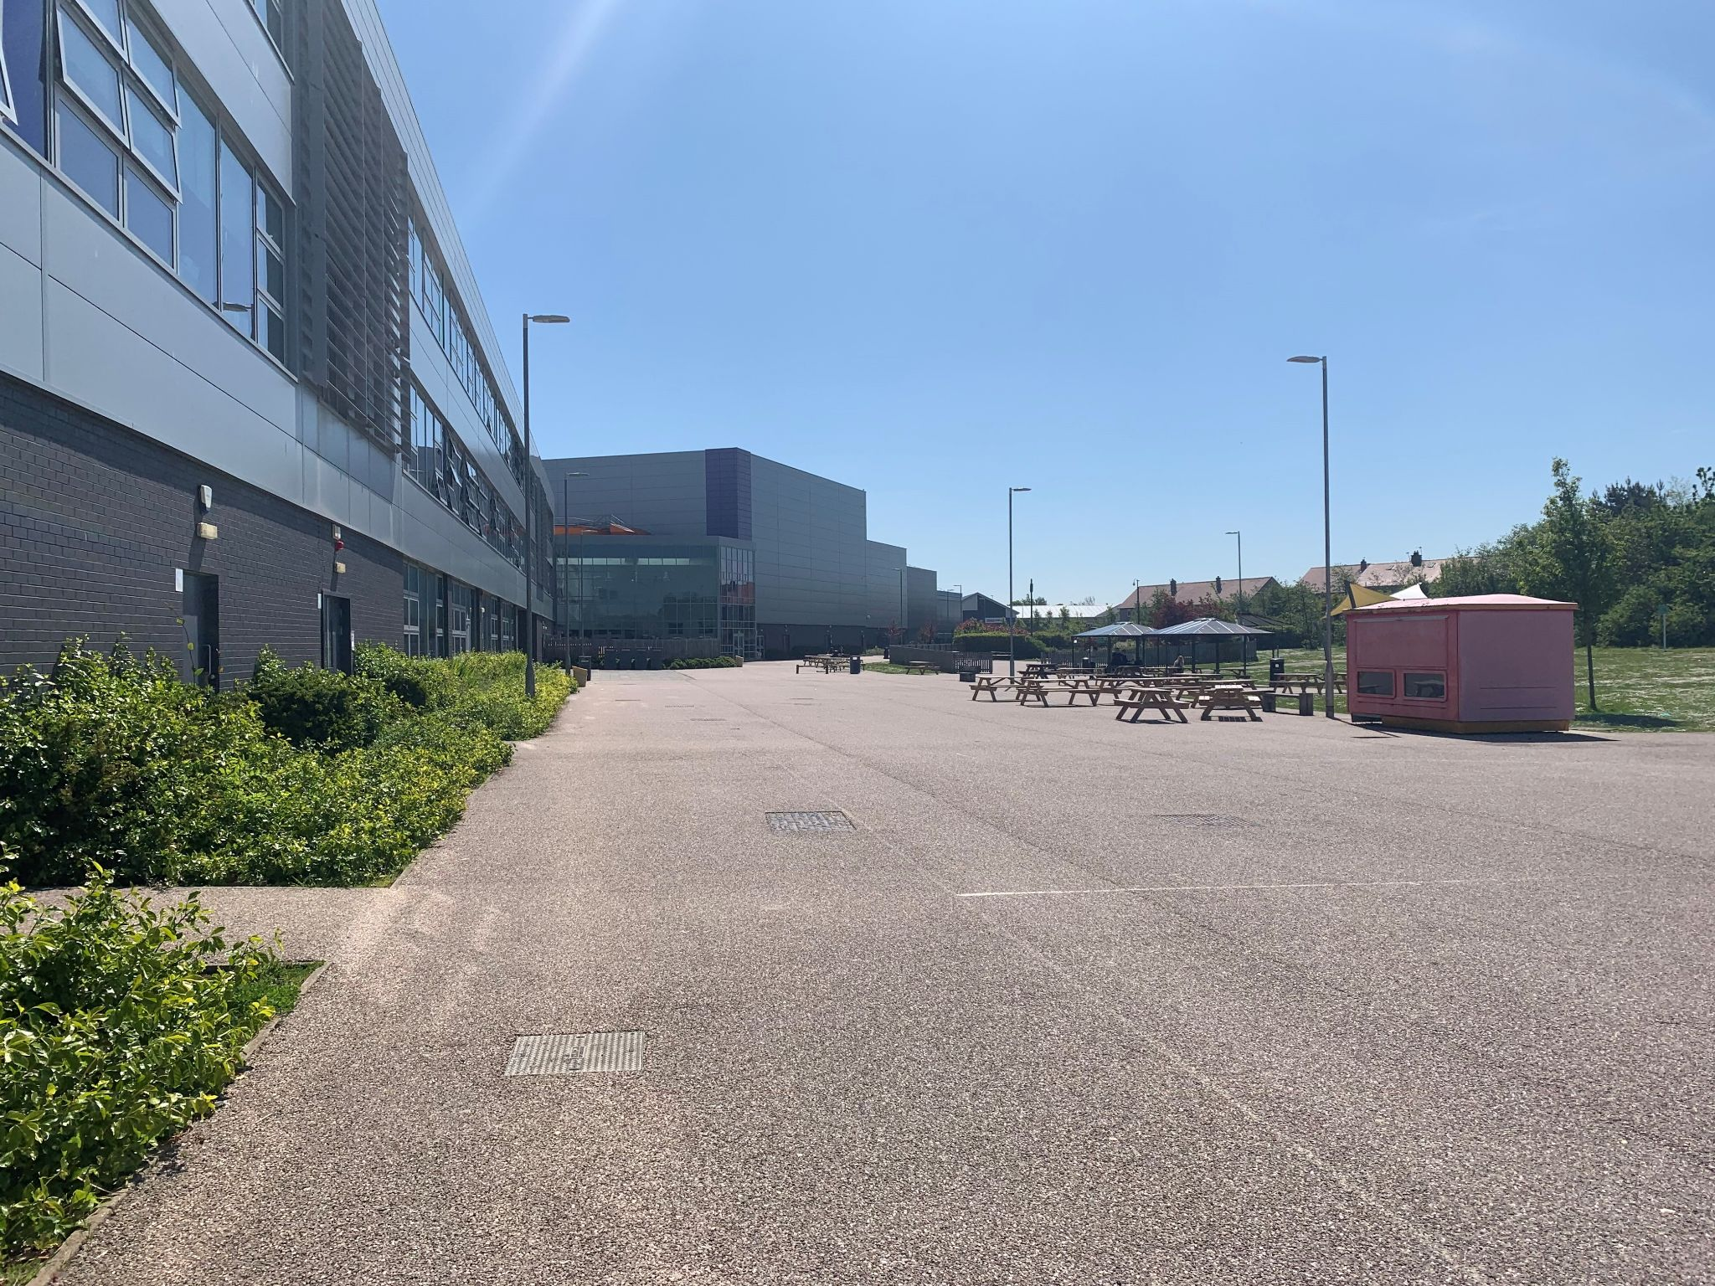
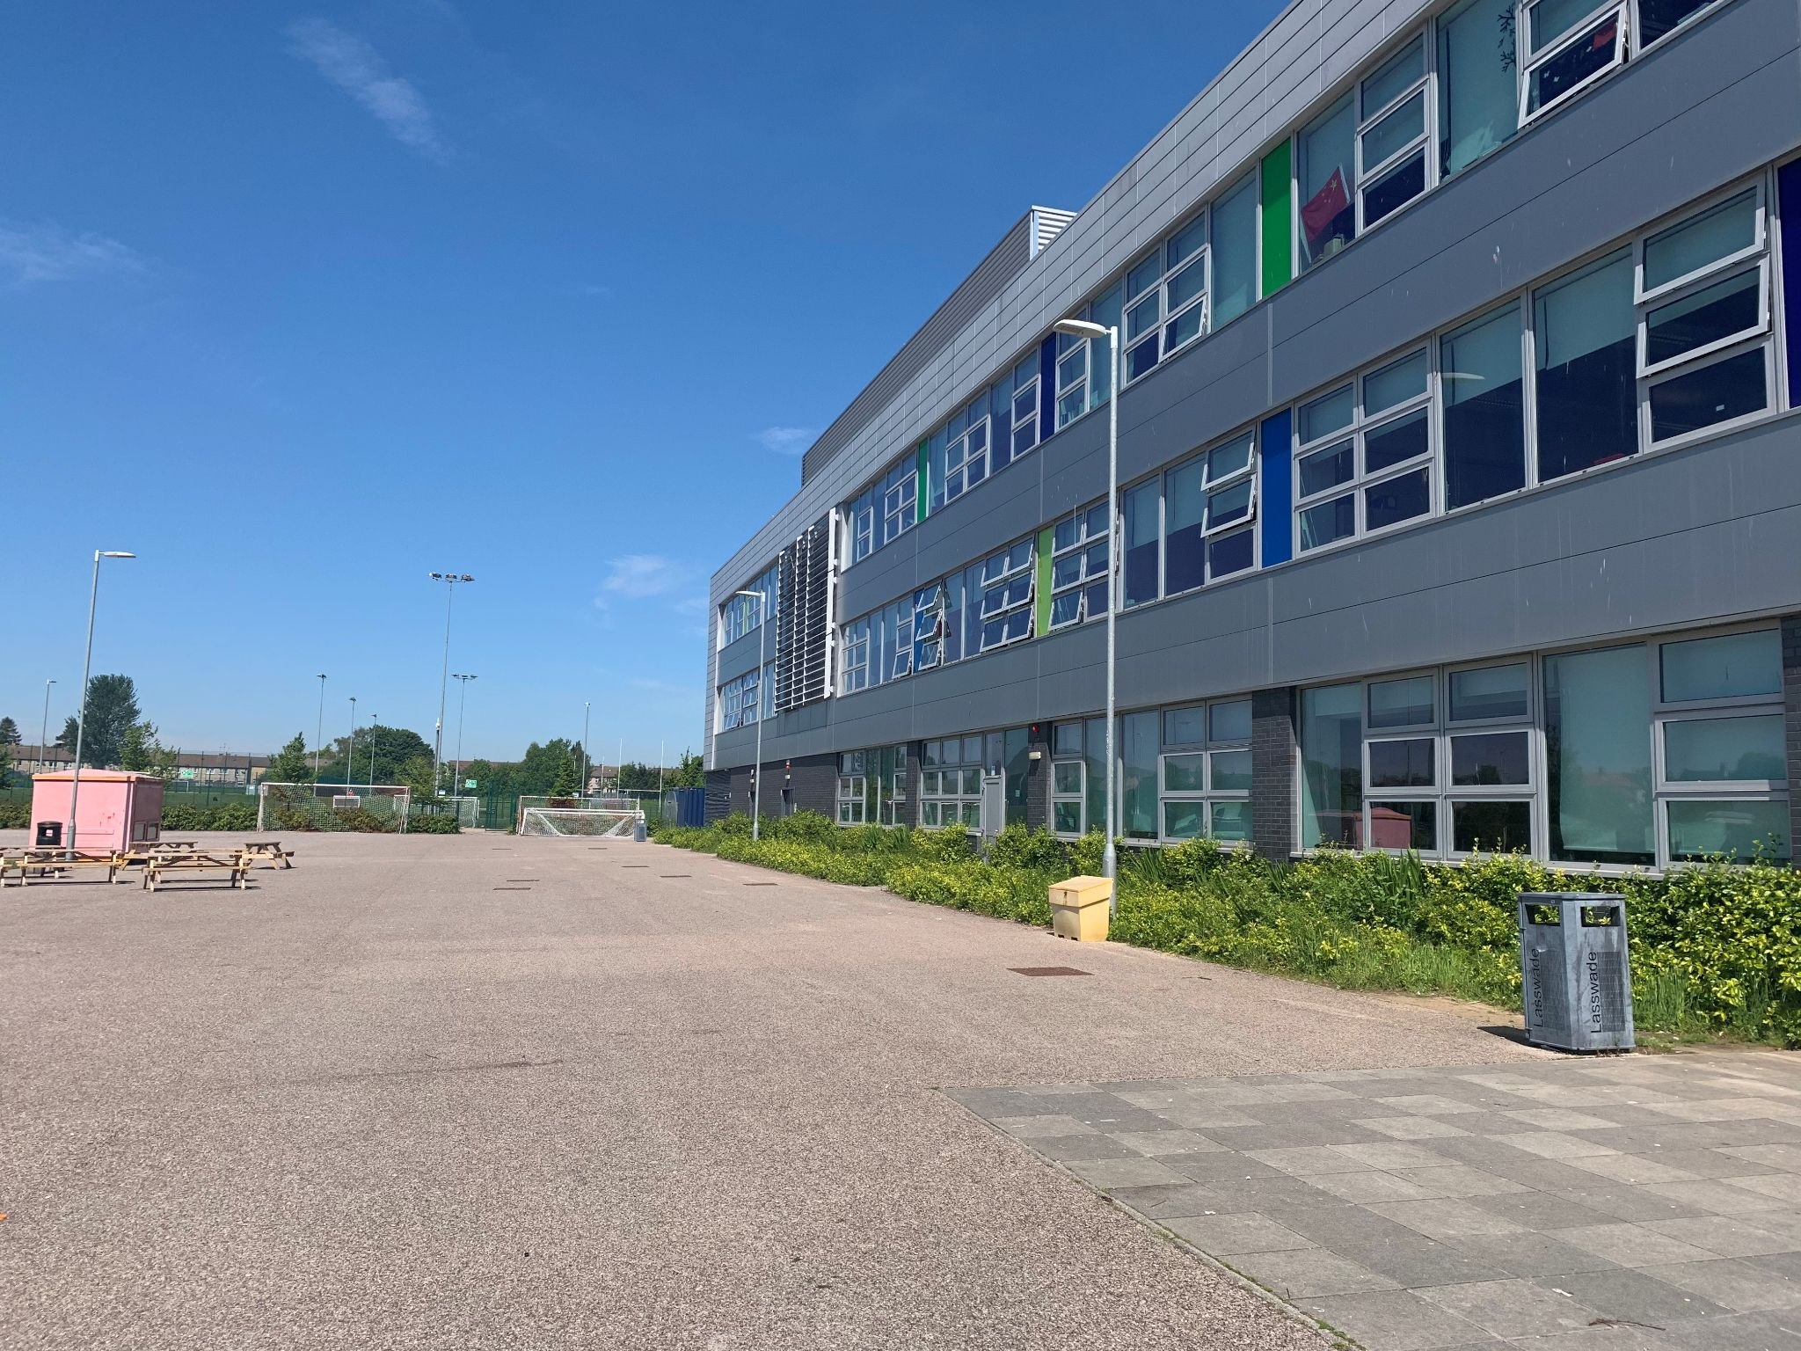
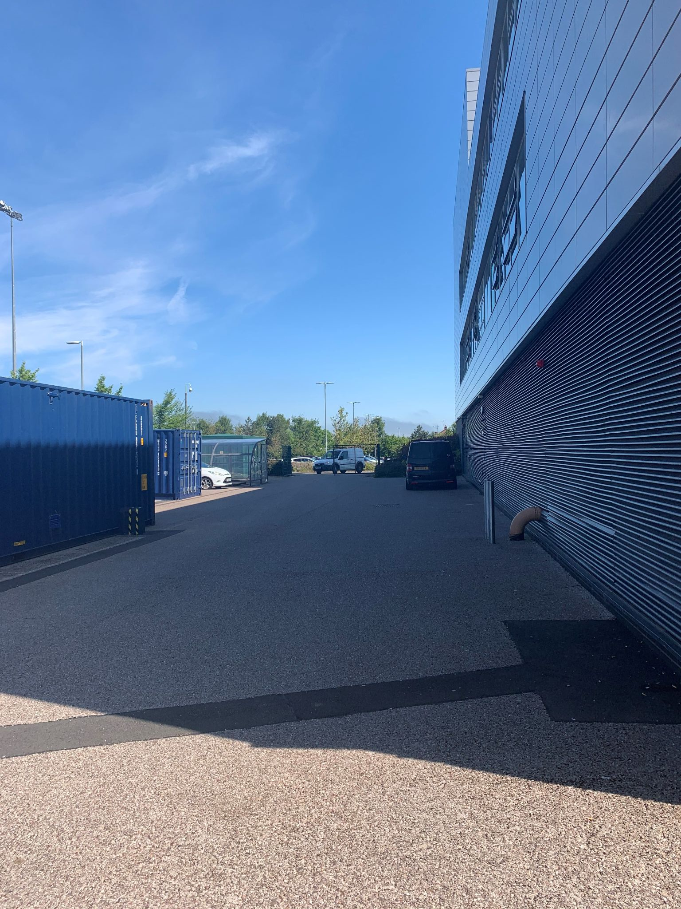
First Day at Lasswade
Where to meet your S6 Buddies: playground
CREATIVITY | EFFORT | KINDNESS | RESPECT
Notes:
CM

Slide 19
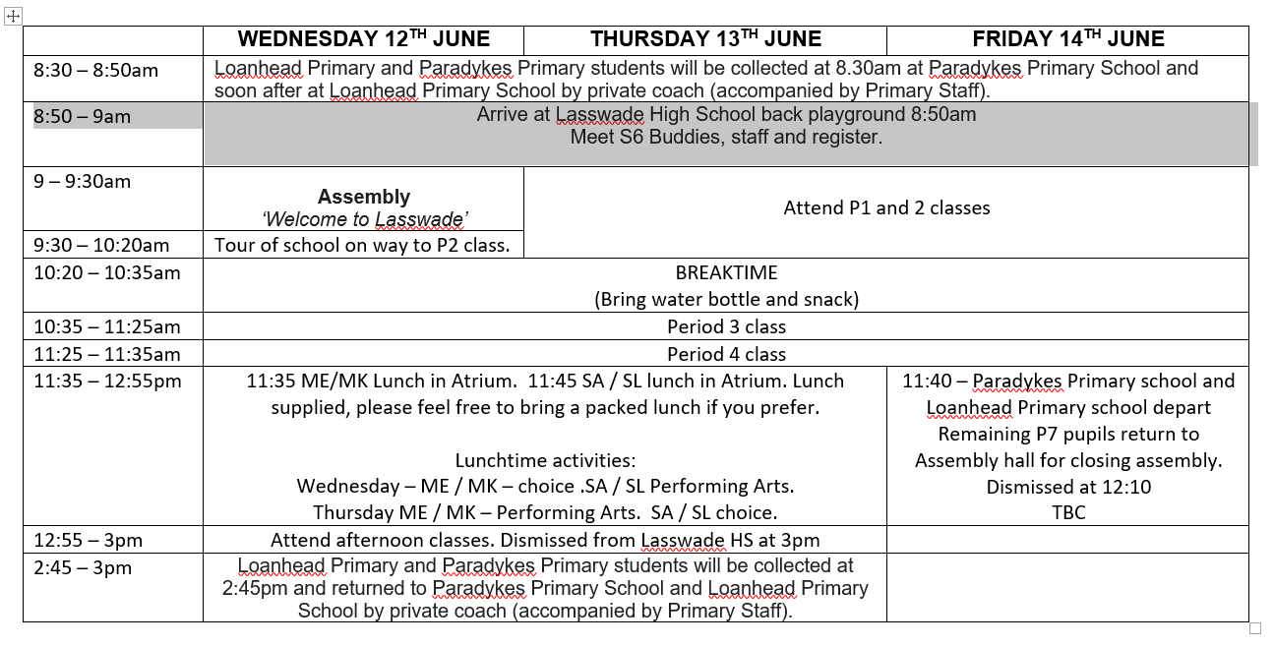
3 Day Plan
Notes:
CM to update

Slide 20
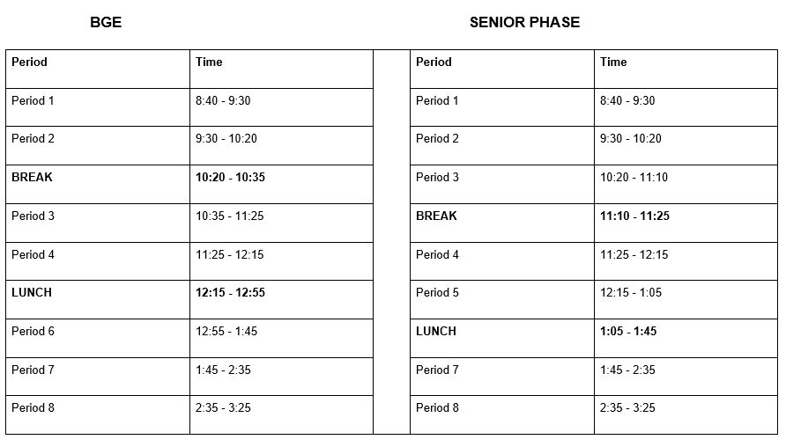
Lasswade High School Day Timings Session 2024 - 25
Monday - Thursday

Slide 21
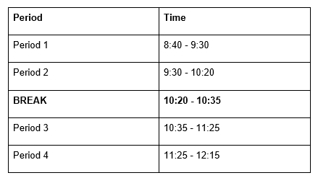
Lasswade High School Day Timings Session 2024 - 25
All Students Friday only

Slide 22
Notes:
CM

Slide 23
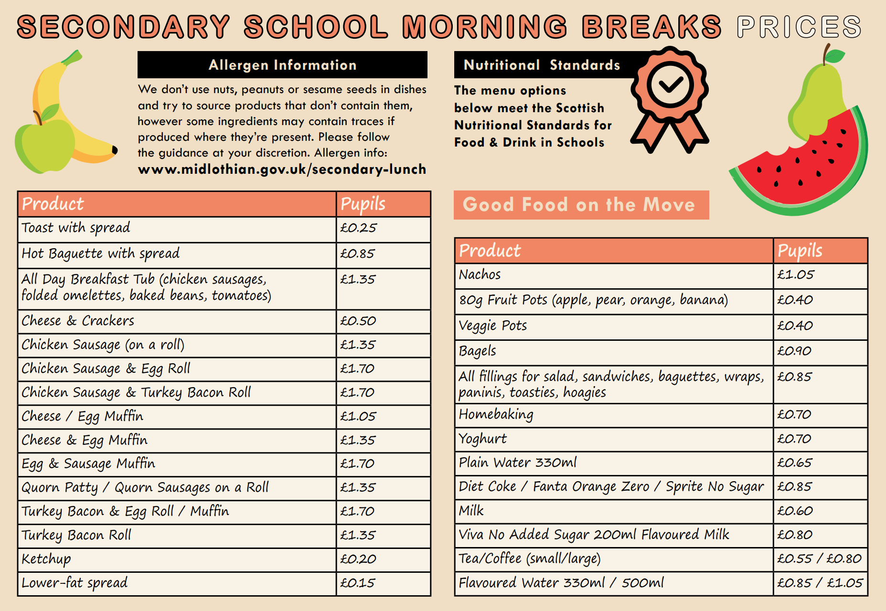
Notes:
CM

Slide 24
Notes:
CM

Slide 25
Notes:
CM

Slide 26
Ingredients and allergens

Slide 27
Contact with Students & Families
P7 Class Visits (this week)
Ties & Information Cards (Monday 10th June)
Timetables in June (Wed 12th-Fri 14th June),
Final timetables in August
Detailed P7/S1 Lasswade Transition Letter
Maintaining contact:
transition.lasswade@midlothian.education
Social Media
CREATIVITY | EFFORT | KINDNESS | RESPECT

Slide 28
Student & Family Feedback
Student & Parent/Carer Voice
Future Developments & Improvements
Google Form - Survey
Link to be shared with P7 students on P7 Google Classroom families as ‘transition homework’
*Link to be shared on website later*
CREATIVITY | EFFORT | KINDNESS | RESPECT

Slide 29
Communication
You can email your questions ahead of sessions.
Slides will be posted on the website after each session.
@LasswadeHSC
Lasswade High School Parent Council
@lasswadehighschool
http://lasswadehsc.mgfl.net/
transition.lasswade@midlothian.education
CREATIVITY | EFFORT | KINDNESS | RESPECT

Slide 30
Questions?
CREATIVITY | EFFORT | KINDNESS | RESPECT

Slide 31
See you on Wednesday 12th June!

