Slide 1
Lasswade High School DREAM Dream, Believe, Achieve @ Lasswade

Slide 2
P7 Transition 2021:
Family Information Session 1
Lasswade High School DREAM Dream, Believe, Achieve @ Lasswade

Slide 3
AIMS:
Provide further support to students and families transitioning to Lasswade High School in August 2021.
Share useful transition information and connect with key members of staff.
Allow parents/carers to ask questions and clarify their understanding of transition.
Inform students and families of the next steps in the transition process.
Lasswade High School DREAM Dream, Believe, Achieve @ Lasswade

Slide 4
Welcome to Session 1
‘My Lasswade’
Welcome to Lasswade High School
P7/S1 Transition Team Roles & Responsibilities
School Values, School Handbook & Student Voice
Staff Professional Learning
Overall Plan for Sessions
Transition Programme Overview
S6 School Captains & S6 Buddies
Family Learning
Lasswade High School DREAM Dream, Believe, Achieve @ Lasswade

Slide 5
P7/S1 Transition Team Roles & Responsibilities
Mr Hornell Head Teacher
Mrs Brown DHT S1 Year Head
Mrs Yule DHT Student Support
Mrs Fleming PT Creative Learning
Mr McQueen Melville Head of House & Transition Coordinator
Mr Fulton IT Specialist
Lasswade High School DREAM Dream, Believe, Achieve @ Lasswade

Slide 6
Mr Hornell, Head Teacher
School Values
School Handbook; https://lasswadehsc.mgfl.net/school-handbook/
Student Voice
HT’s ‘Mission’; https://m.youtube.com/watch?v=omPdemwaNzQ
*All links will be shared on the school website by the end of this week.
Lasswade High School DREAM Dream, Believe, Achieve @ Lasswade

Slide 7
Miss Montague, PT BGE Creative Design
Staff Professional Learning
E-Learning Focus
Impact on our Students and School
Lasswade High School DREAM Dream, Believe, Achieve @ Lasswade

Slide 8
Plan for Sessions
‘My Lasswade’ Tuesday 27th April 6pm
‘My Learning’ Wednesday 12th May 6pm
‘My Support’ Thursday 3rd June 6pm
*Zoom Joining Details will be sent out to families (via Primary Schools) in advance.
*Please get in touch if you are from an out of catchment Primary School.
Lasswade High School DREAM Dream, Believe, Achieve @ Lasswade

Slide 9
Transition Programme Overview
Virtual P7 Transition:
Online, clear, fun and interactive
Shared with P7 students on Google Classroom (class code: vucuxjs)
Midlothian guarantees Chromebooks for all P7 students during Transition
Monday 14th - Friday 18th June (during class)
P7 Teachers and Support Assistants
‘My Lasswade’, ‘My Learning’, ‘My Support’
Activities are flexible and interlinked
Allows students to work at their own pace
Elements of personalisation and choice
Lasswade High School DREAM Dream, Believe, Achieve @ Lasswade

Slide 10
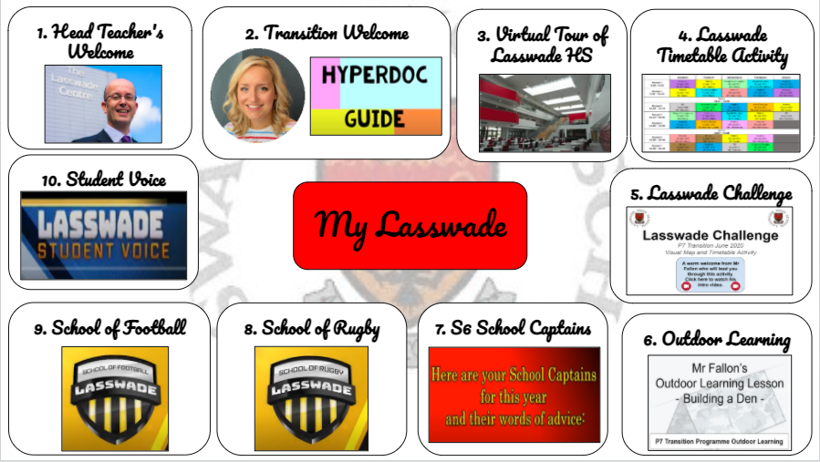
Transition Programme Overview
‘My Lasswade’
Students should follow each of the ‘hyper docs’ by using the numbers.
Each of the bubbles are clickable and interactive.
Videos with instructions explain each of the activities.
Students should take their time and enjoy the activities!
Lasswade High School DREAM Dream, Believe, Achieve @ Lasswade

Slide 11
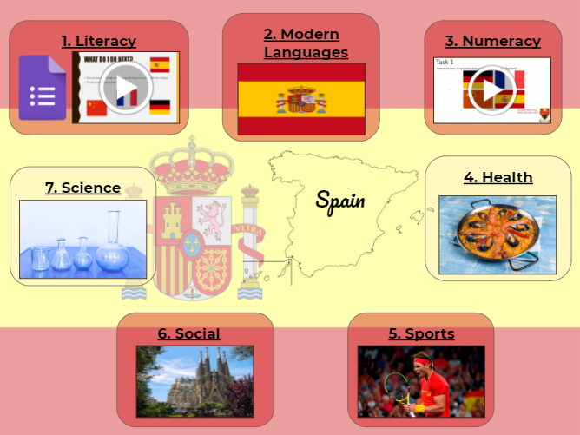
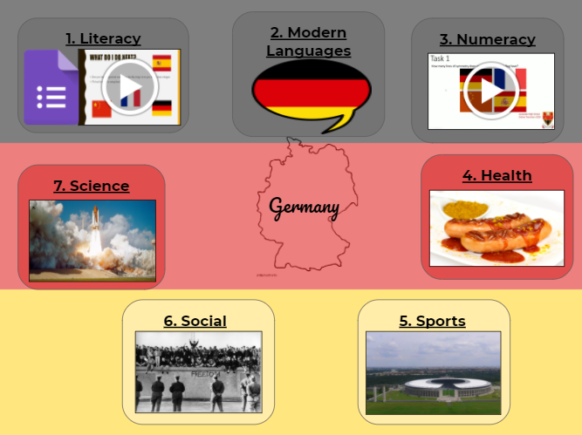
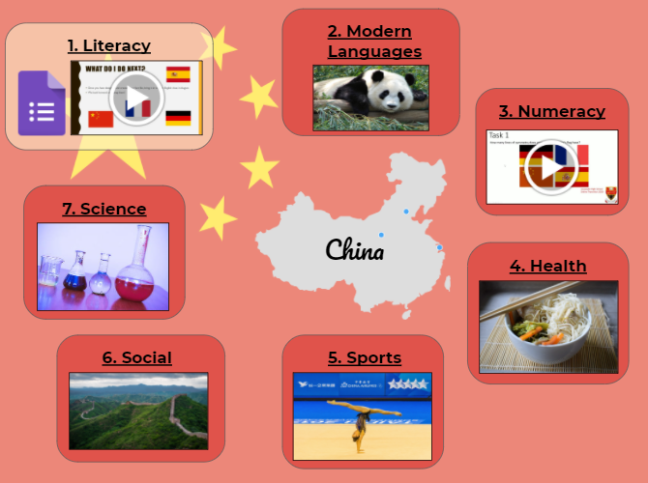
Transition Programme Overview
2. ‘My Learning’
Students choose from one of the four Modern Languages we teach at Lasswade for this section.
Modern Languages at LHS:
French
German
Mandarin
Spanish
Lasswade High School DREAM Dream, Believe, Achieve @ Lasswade

Slide 12
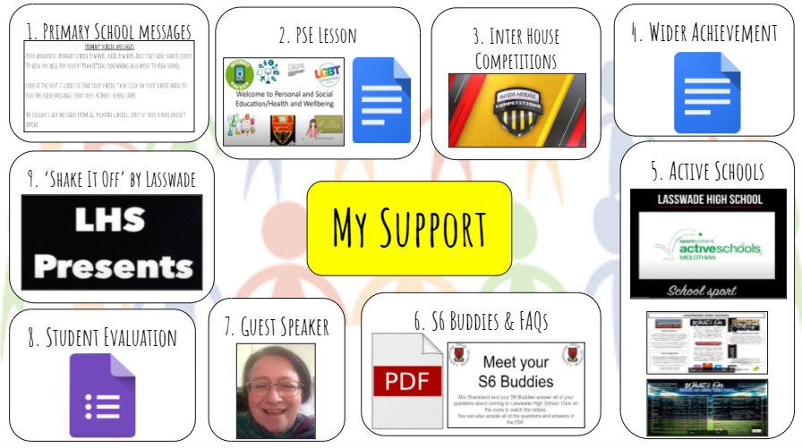
Transition Programme Overview
3. ‘My Support’
Student Support, PSE & S1 Personal Support
Inter House Competitions: Melville, Mount Esk, St Anne’s & St Leonard’s
Active School & Wider Achievement
S6 Buddies & FAQs
Lasswade High School DREAM Dream, Believe, Achieve @ Lasswade

Slide 13
Transition Programme Overview
P7 Transition 2020 Student Feedback
“Our S6 Buddies were amazing! They helped us get around the school, they visited us in classes and they were really friendly.”
“Lasswade is a really big school but the virtual tour helped me a lot. I felt that I sort of knew where I was going before I even started S1 in August.”
“During transition, just like in school, the teachers will give you a lot of support and very clear instructions. Don’t worry about the transition activities, you’ll be great at them!”
“The transition activities were really fun and different. We got to learn a lot about Lasswade and meet lots of staff and our S6 Buddies.”
Lasswade High School DREAM Dream, Believe, Achieve @ Lasswade

Slide 14
S6 School Captains & S6 Buddies
Ria & Maisie
Roles & responsibilities
Learning, planning, projects, skills
P7 Transition Challenges:
Curricular & S5 Students
S6 Buddies Training
May-June with future S6 Buddies
Lasswade High School DREAM Dream, Believe, Achieve @ Lasswade

Slide 15
Family Learning
P7/S1 Family Learning Bulletin:
Literacy, Numeracy, Health, Sports
Family e-Learning @ Lasswade:
Google Classroom, Notifications, Assignments, Deadlines
Wellbeing:
Motivation, Stress, Anxiety
Ideas for future plans at Lasswade?
Lasswade High School DREAM Dream, Believe, Achieve @ Lasswade

Slide 16
Communication
You can email your questions ahead of sessions.
Slides will be posted on the website after each session.
@LasswadeHSC
Lasswade High School Parent Council
@lasswadehighschool
http://lasswadehsc.mgfl.net/
transition.lasswade@mgfl.net
Lasswade High School DREAM Dream, Believe, Achieve @ Lasswade

Slide 17
Questions?
Lasswade High School DREAM Dream, Believe, Achieve @ Lasswade

Slide 18
Staff Speakers
S6 Students
P7 Students
Families
See you next time: Wednesday 12th May
Zoom details to follow

